Slide 1
CST8250
Introduction to ER Diagrams and Database Design
Week 1

Slide 2
Overview
Review: Keys
Basic parts of a table
Entities defined
Attributes defined
Relationships defined
Types of entities
Types of attributes
Identifiers (Keys)
Types of relationships
Cardinality
Main elements of data modelling

Slide 3
Review: Keys

Slide 4
Review: Keys
We must have the ability to uniquely identify each row in a table
This is achieved by creating keys for each row
This ensures that no row in a table can have exactly the same values for all attributes
Unique rows mean we can count items in the table i.e number of people
Person
SIN
name
Primary key

Slide 5
Review: Keys
What would happen if we didn’t uniquely identify each row?
Data would be duplicated
We wouldn’t be able to count rows and get any meaningful information
The integrity, quality, accuracy, and reliability of our data would be compromised
The main role of keys is to form relationships with other tables, how could we achieve this if the data in our tables were not organized? We wouldn’t be able to form relationships with other tables without keys.
Writing queries would be difficult and complex – WHERE clause

Slide 6
Types of Keys
Many types of keys, these are the ones we must understand in this course:
Primary Key: one or many columns (attributes) that uniquely identify each row in a database
Foreign Key: a primary key from ANOTHER table that is used to form a relationship with the other table through the key
Composite Key: a primary key that consists of more than one column
NOTE: these are NOT exclusive terms, a key can fit the criteria of all of these terms and be considered all three i.e. a primary key, a foreign key and a composite key

Slide 7
Primary Keys
Primary Key: one or many columns (attributes) that uniquely identify each row in a database
a key is typically a sequence of numbers such that no number will be repeated within the table
it is possible to use other values as long as they will be guaranteed to be unique
A primary key CANNOT be null! A primary key MUST be unique!
We use an auto-generated id when none of the attributes in the table are suitable as a primary key
Ex: SIN, email address, auto-generated id, driver’s license number

Slide 8
Foreign Keys
Foreign Key: a primary key from ANOTHER table that is used to form a relationship with the other table through the key
Does not have to follow the rules of a primary key: must be unique, but CAN be null
A foreign key can become part of the primary key of the new table as it’s likely needed to uniquely identify each row in the table based on the relationship. If the foreign key becomes part of the primary key, it can no longer be null.
Note that since this follows the definition of a primary key, a foreign key can also be one or more columns in a table
Uniquely identifies a row in another table

Slide 9
Composite Keys
Composite Key: a primary key that consists of more than one column
It is possible that more than one column in the table can be used to uniquely identify each row, in this case the primary key is also called a composite key
If it makes sense to use existing columns in the table rather than adding an auto-generated id column, this will save some resources. One should consider complexity and clarity when choosing this option.

Slide 10
Keys Example #1
Capture the historical data of courses a student has registered in.
Both Student Id and Course Id are part of the primary key, together they form the composite key

Slide 11
Keys Example #2
Link the customer to the order.
The foreign key also becomes part of the primary key, we need to know who placed each order

Slide 12
Data Modelling Intro

Slide 13
Basic parts of a table
All tables normally have:
Table name: Person
Columns identified by a name: SIN, Name
Rows identified by a set of column values
(123 456 789, John Doe)
A primary key. A primary key is used to uniquely identify a single row of data
Person
SIN
Name
SIN | Name
123 456 789 | John Doe
456 789 123 | Jane Doe
13

Slide 14
Entities
Entity – a person, a place, an object, an event, or a concept in the user environment about which the organization wishes to maintain data
Entity type – a collection of entities that share common properties or characteristics
Entity instance – A single occurrence of an entity type

Slide 15
Entity Example
Entity – shortened word we use to refer to entity type
Entity type – Person
Entity instance – John Doe
Table name is an entity
Person
SIN
name

Slide 16
Attributes
An attribute is a property or characteristic of an entity or a relationship
A description of an entity
Often nouns
All attributes have values

Slide 17
Attribute Example
An attribute is a property or characteristic of an entity or a relationship
A description of an entity
A Person can be described by a SIN and their name
Columns are attributes
Person
SIN
name

Slide 18
Relationships
Describes how entities associate with one another
Often verbs
Three types:
One to one
One to many
Many to many

Slide 19
Relationships Example
Describes how entities associate with one another
We use Crow’s Foot notation in this course
Professor
Office
A professor has one office – one to one

Slide 20
Entity-Relationship (ER) Model Constructs
Entities:
Entity instance: person, place, object, event, concept (often corresponds to a row in a table)
Entity Type: collection of entities (often corresponds to a table)
Relationships:
Relationship instance: link between entities (corresponds to primary key-foreign key equivalencies in related tables)
Relationship type: category of relationship, link between entity types
Attributes:
Properties or characteristics of an entity or relationship type (often corresponds to a field/column in a table)

Slide 21
Entities

Slide 22
An Entity…
SHOULD BE:
An object that will have many instances in the database
An object that will be composed of multiple attributes
An object that we are trying to model
SHOULD NOT BE:
A user of the database system
An output of the database system (e.g. a report)

Slide 23
Types of Entities
Strong Entity
Has a primary key
Independent of other entities
Weak Entity
Does NOT have a primary key
Dependent on another entity

Slide 24
Types of Entities (cont.)
Loan
Payment
Loan is a strong entity as it can exist on its own and can be uniquely
identified by a primary key such as loan_number
Payment is a weak entity as we cannot make a payment
unless it has a Loan, it is dependent on Loan
Concept only, weak entities to be discussed further

Slide 25
Attributes

Slide 26
Types of Attributes
Attribute: property or characteristic of an entity or relationship type
Classifications of attributes:
Required versus Optional Attributes
Simple versus Composite Attribute
Single-Valued versus Multivalued Attribute
Stored versus Derived Attributes
Identifier Attributes

Slide 27
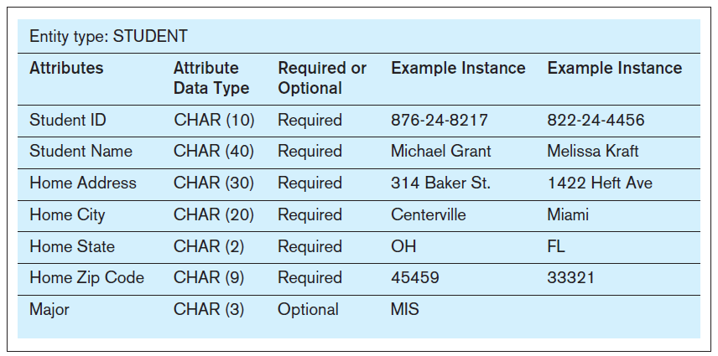
Required vs. Optional Attributes
Required – must have a value for every entity (or relationship) instance with which it is associated
Optional – may not have a value for every entity (or relationship) instance with which it is associated

Slide 28
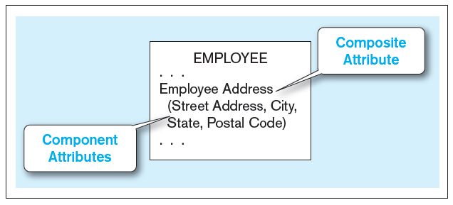
Simple vs. Composite Attributes
Simple attribute – An single attribute that can hold one value
Composite attribute – An attribute that has meaningful component parts (attributes)
The address is broken into component parts
Is COMPOSED of many parts
A composite attribute
28

Slide 29
Simple vs. Composite Attributes (cont.)
Simple attribute – An single attribute that can hold one value
Composite attribute – An attribute that has meaningful component parts (attributes)
Middle name
Simple
First
name
Last name
Code
Title
Composite
Name
Course
Student

Slide 30
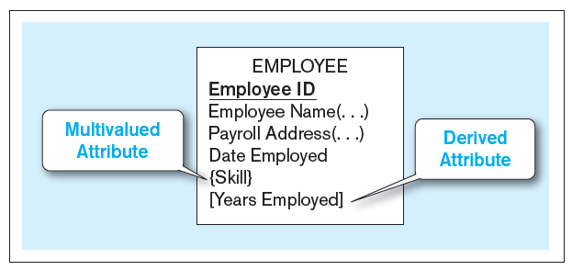
Multivalued and Derived Attributes
Multivalued – may take on more than one value for a given entity (or relationship) instance
Derived – values can be calculated from related attribute values (not physically stored in the database)
Entity with multivalued attribute (Skill) and derived attribute (Years Employed)
Derived
Calculated from date employed and current date
Multivalued
an employee can have more than one skill
Has MULTIPLE values – a LIST
30

Slide 31
Defining Attributes
State what the attribute is and possibly why it is important
Make it clear what is and is not included in the attribute’s value
Include aliases in documentation
State source of values
State whether attribute value can change once set
Specify required vs. optional
State min and max number of occurrences allowed
Indicate relationships with other attributes

Slide 32
Identifiers (Keys)
Identifier (Key): an attribute (or combination of attributes) that uniquely identifies individual instances of an entity type
Simple versus Composite Identifier
Candidate Identifier: an attribute that could be an identifier, satisfies the requirements for being an identifier

Slide 33
Identifiers (Keys)
Identifier (Key): an attribute (or combination of attributes) that uniquely identifies individual instances of an entity type
Code
Title
Code | Title
CST8250 | Database Design and Administration
CST8110 | Intro to Computer Programming
Course
Good design?

Slide 34
Identifiers (Keys) cont.
What if there is more than one section?
Reminder that a unique identifier should uniquely identify EACH row
Section
Section
Title
Design decision
Code
Title
Code
Course
Number
Course
Course

Slide 35
Criteria for Identifiers
Choose Identifiers that
Will not change in value
Will not be null
Avoid intelligent identifiers (e.g., containing locations or people that might change)
Substitute new, simple keys for long, composite keys

Slide 36
Relationships

Slide 37
Types of Relationships
One-to-One
Each entity in the relationship will have exactly one related entity
One-to-Many
An entity on one side of the relationship can have many related entities, but an entity on the other side will have a maximum of one related entity
Many-to-Many
Entities on both sides of the relationship can have many related entities on the other side

Slide 38
Degree of Relationships
Degree of a relationship is the number of entity types that participate in it
Unary Relationship
Binary Relationship
Ternary Relationship
Most are binary

Slide 39
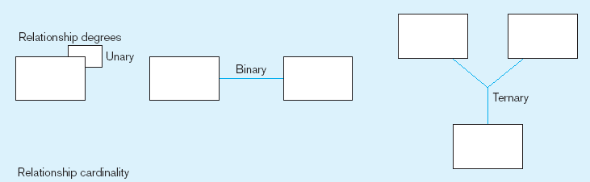
Degree of Relationships (cont.)
Entities of two different types related to each other
One entity related to another of the same entity type
Entities of three different types related to each other

Slide 40
Unary Relationship Example
An entity related to another entity of the SAME type
Manages
Employee
An Employee manages one to many Employees
The manager is also an Employee

Slide 41
Binary Relationship Example
TWO entities related to each other
Employee
Department
works in
An Employee works in one to one Department
An Employee has one and only one Department

Slide 42
Ternary Relationship Example
THREE entities related to each other, uncommon
Professor
Student
Course
teach
A Professor teaches one to many Courses
A Professor teaches one to many Students
Many Students are taught by one Professor

Slide 43
Cardinality Constraints
Cardinality Constraints: the number of instances of one entity that can or must be associated with each instance of another entity
We add minimum and maximum constraints to the relationship
Minimum Cardinality
If zero, then optional
If one or many, then mandatory
Maximum Cardinality
The maximum number
Zero = optional
One = mandatory
Many = mandatory

Slide 44
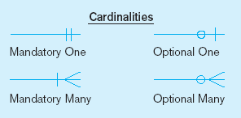
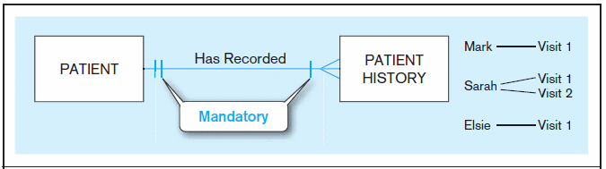
Examples of Cardinality Constraints
A patient history is recorded for one and only one patient
A patient must have recorded at least one history, and can have many

Slide 45
Examples of Cardinality Constraints (cont.)
One to Many relationship - mandatory
Cardinality is minimum one, maximum many
A flight needs a minimum of one attendant
A flight can have a maximum of many attendants
AC123
Joe
Sue
LH456
Bob
BA231
Alice
Tom
Flight
Flight Attendant

Slide 46
Examples of Cardinality Constraints (cont.)
One to Many relationship - mandatory
Cardinality is minimum one to one, maximum one to many
One flight needs a minimum of one attendant
One flight can have a maximum of many attendants
One attendant has a minimum of one flight and a maximum of one flight
Flight
Attendant
Relationship read as:
Flight has one to many Attendants
Attendant has one and only one flight

Slide 47
Examples of Cardinality Constraints (cont.)
One to Many relationship - optional
Cardinality is minimum zero, maximum many
One professor teaches a minimum of zero classes (annual leave or sabbatical)
One professor teaches a maximum of many classes
One class has a minimum of zero professor (not offered)
One class has a maximum of one professor
Bob
CST1
CST2
Sue
CST3
Jim
CST4
CST5
Professor
Class

Slide 48
Examples of Cardinality Constraints (cont.)
One to Many relationship – optional
Cardinality is minimum zero to zero, maximum one to many
One professor teaches a minimum of zero classes (annual leave or sabbatical)
One professor teaches a maximum of many classes
One class has a minimum of zero professor (not offered)
One class has a maximum of one professor
Professor
Class
Relationship read as:
Professor has one to many Classes
A Class has one and only one Professor

Slide 49
Naming conventions
Used to be loose and free
Because of original space constraints, naming used to be pretty cryptic
Each company had it’s own standards
Often each developer had his/her own version
Could cause all kinds of grief
Thanks to modern development frameworks, a defacto standard is starting to emerge

Slide 50
Naming conventions used in this course
Everything is lower case. No exceptions.
No spaces. Use an underscore.
Tables are plural whenever possible. Exceptions would be names that imply plurality such as “log”
Primary keys are called “id”
Foreign keys are named using the rule of” singular parent table name + underscore + primary key name”. i.e. “Users” table with PK “id” would have a foreign key name of “user_id”.

